Slide 1
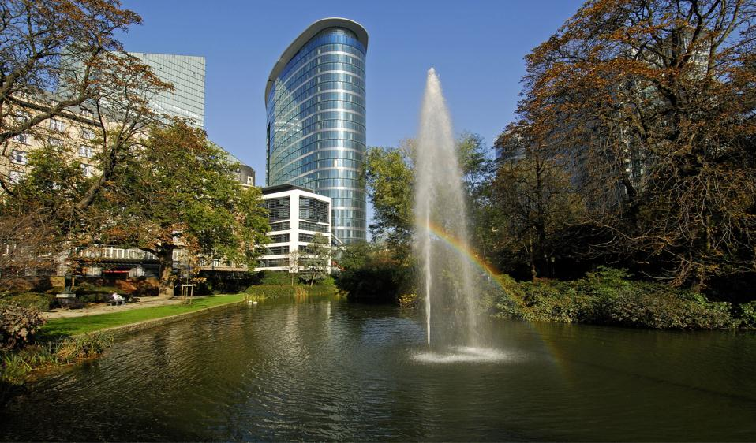
The European Research Council
ERC: a European Success Story
Jean-Pierre BOURGUIGNON
ERC President
© Art & Build Architect / Montois Partners / credits: S. Brison
January 2018

Slide 2
The Mission and Structure
of the ERC

Slide 3
What is the ERC?
The ERC supports frontier research projects through a bottom-up, individual-based, pan-European competition
Support for the individual scientists – no networks!
Global peer-review
No predetermined subjects (bottom-up)
Support of frontier research in all fields of science and
humanities
Strategy
Scientific governance: independent Scientific Council with 22 members including the ERC President; full authority over funding strategy and evaluation
Support by the ERC Executive Agency (autonomous)
Scientific quality as the only criterion aiming for excellence
Legislation

Slide 4
ERC: a Radical Step Forward for Europe
Mission: To raise the level, dynamism and creativity of the whole European research system by:
Supporting the emergence of research leaders in Europe capable of opening new avenues in their disciplines and of training and inspiring others
Improving the career prospects of early stage researchers in Europe so as to reduce brain drain and promote institutional change
Providing a benchmark for all of Europe’s national research authorities and individual institutions encouraging further efforts, reforms and investments, thereby sustaining structural reforms across Europe.

Slide 5
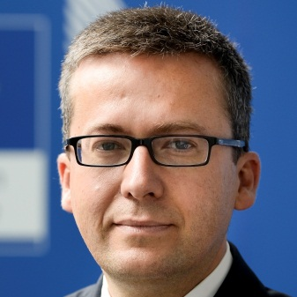
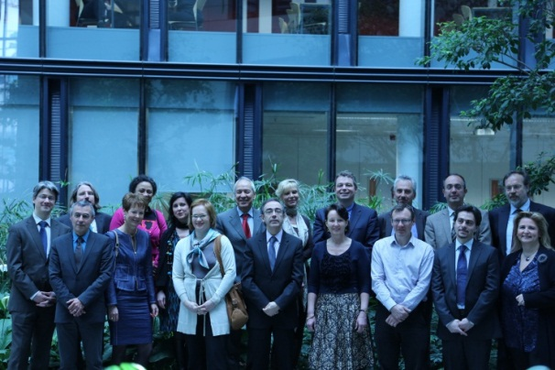
ERC Structure
The European Commission
Provides financing through the EU framework programmes
Guarantees autonomy of the ERC
Assures the integrity and accountability of the ERC
Adopts annual work programmes as established by
the Scientific Council
The ERC Scientific Council
21 prominent researchers proposed by an independent
identification committee
President appointed following recommendation of an independent search committee
Appointed by the Commission (4 years, renewable once)
Establishes overall scientific strategy; annual work programmes
(incl. calls for proposals, evaluation criteria); peer review methodology;
selection and accreditation of experts
Controls quality of operations and management
Ensures communication with the scientific community
The ERC Executive Agency
Executes annual work programme as established by the Scientific Council
Implements calls for proposals and provides information and support to applicants
Organises peer review evaluation
Establishes and manages grant agreements
Administers scientific and financial aspects and follow-up of grant agreements
Carries out communications activities and ensures information dissemination
to ERC stakeholders

Slide 6
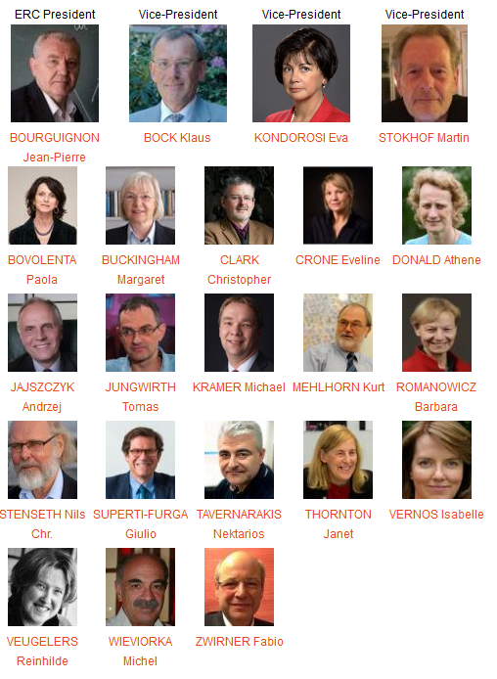
Governance by the Scientific Council

Slide 7
ERC Grant Schemes
Starting Grants
starters
(2-7 years after PhD) up to € 1.5 Mio
for 5 years
Consolidator Grants
consolidators
(7-12 years after PhD) up to € 2 Mio
for 5 years
Advanced Grants
track-record of
significant research
achievements in the
last 10 years
up to € 2.5 Mio
for 5 years
Proof-of-Concept
bridging gap between research - earliest stage of marketable innovation
up to €150,000 for ERC grant holders
Synergy Grants (re-launched 2018)
2 – 4 Principal Investigators
up to € 10.0 Mio for 6 years

Slide 8
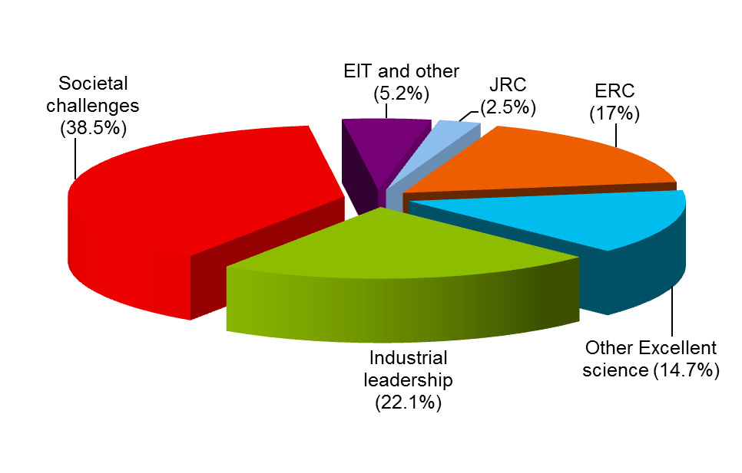
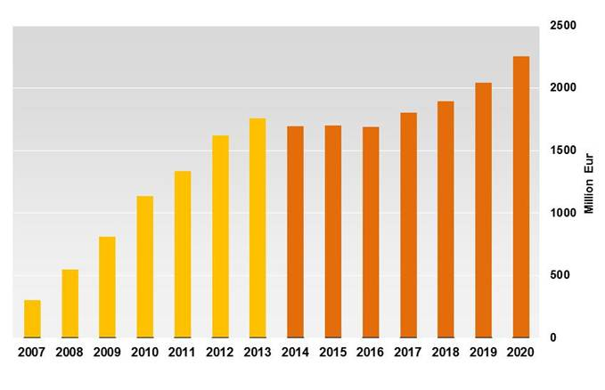

Horizon 2020 Budget and ERC
ERC Budget 2014-2020 13 billion €

Slide 9
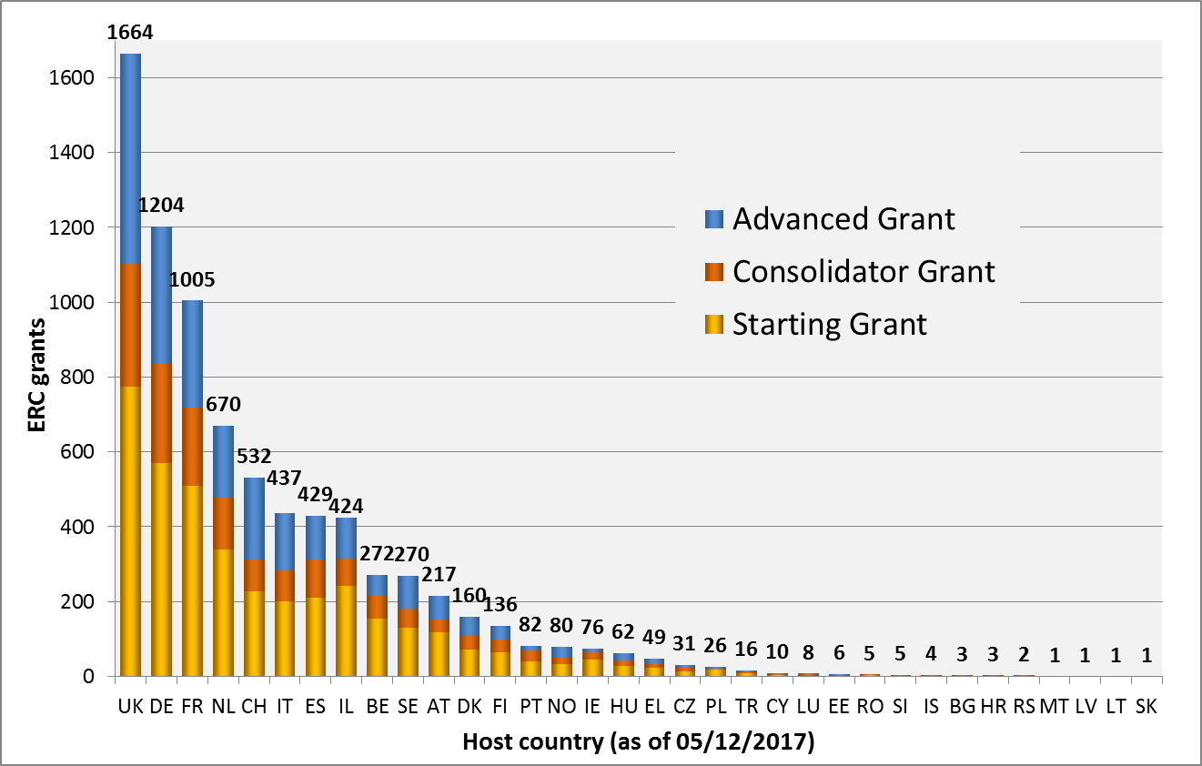
ERC Funded Projects by Country of HI

Slide 10
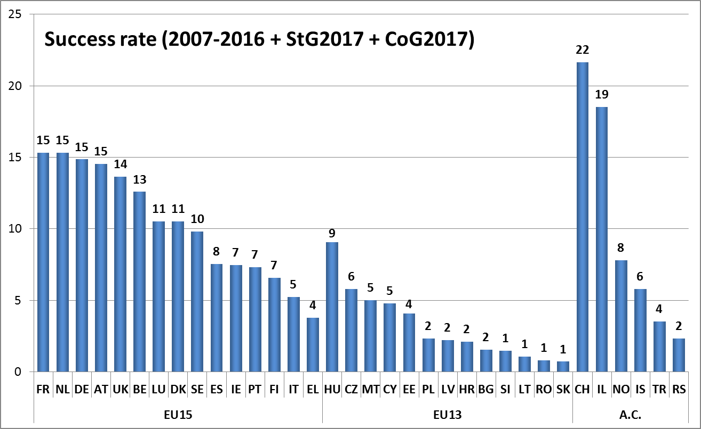
Success Rate by Country of HI

Slide 11
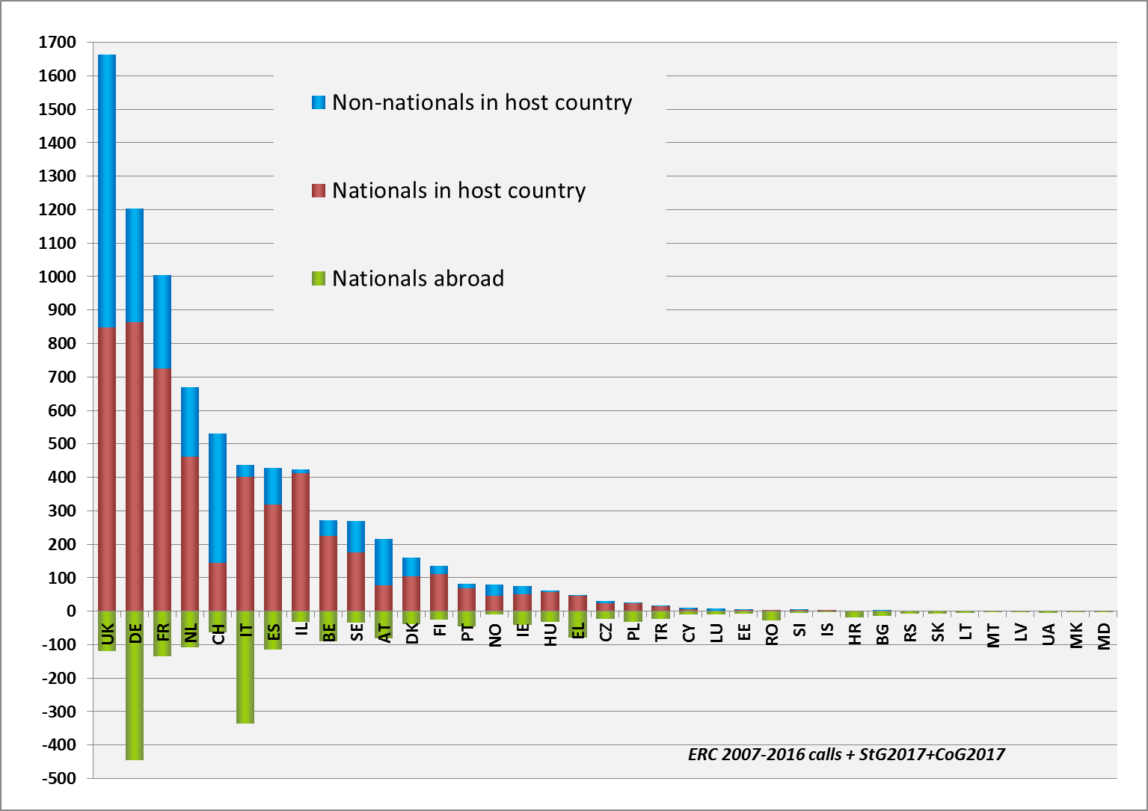
Grantees at Home and Abroad
1 foreign PI in Bulgaria
14 Bulgarian PIs abroad,
most in UK(5), AT(3) and FR(3)

Slide 12
ERC Grantees in Bulgaria
PoC-2017
Prof. Stoyan Kostadinov SMOUKOV (Sofia University)
Title: Bottom-up Energy Efficient Emulsification and Structured Materials
(He had a StG 2011 at the University of Cambridge)

Slide 13
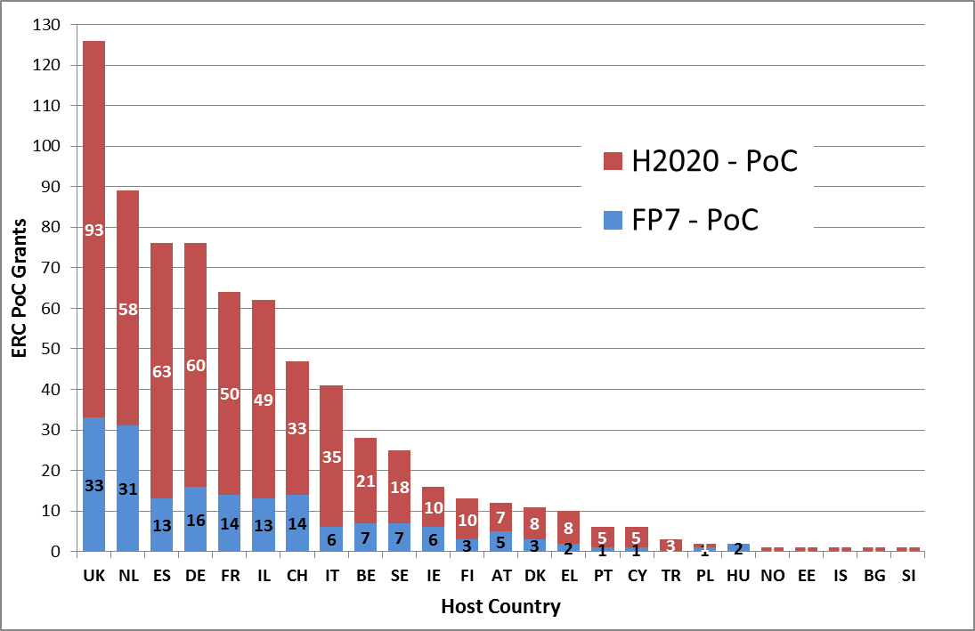
ERC Proof of Concept 2011-2017

Slide 14
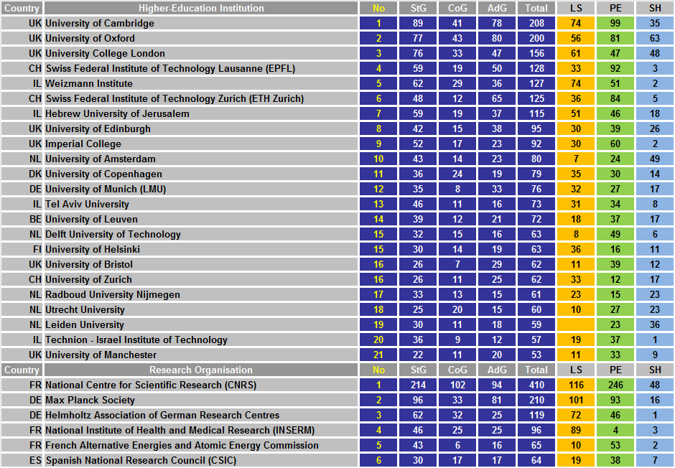
Top
European Institutions
Hosting
ERC Grantees
by Funding
Schemes
ERC calls 2007-2016
StG2017 and CoG2017
Current signatories
of the grant agreement
Data as of 05/12/2017

Slide 15
ERC Delivers

Slide 16
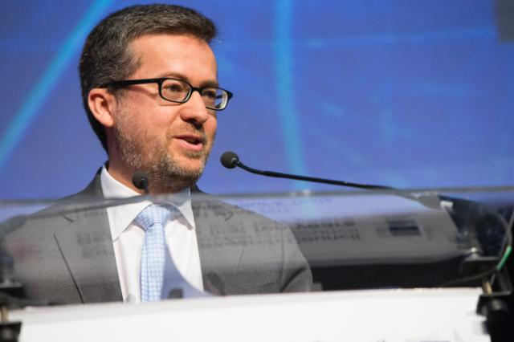
ERC 10th Year Anniversary Celebration
"Today's event is one of the most important in my tenure as a Commissioner for one simple reason: You are our jewel in the crown. You are one of the best things to happen in Europe in the last 10 years."
ERC 10th anniversary Speech by Commissioner MOEDAS, 21 March 2017
ERC was spontaneously celebrated in >160 events all over Europe and the world; from national events with Heads of States and Ministers, to universities and EU delegations worldwide.

Slide 17
After 10 Years, a Success Story
7,500
90,000
738
50,000
€ 13 billion
72

Slide 18
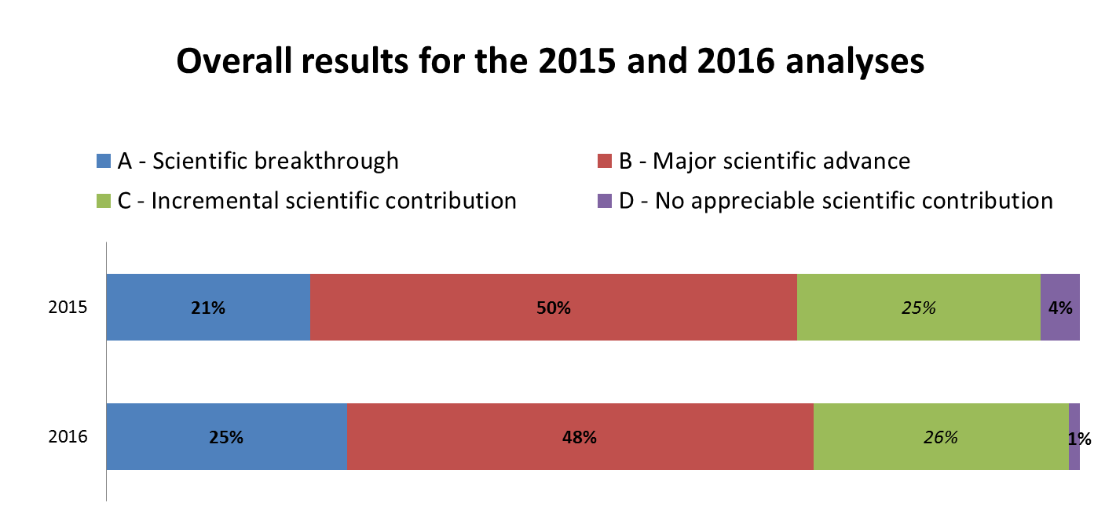
Results of the ex-post Analysis

Slide 19

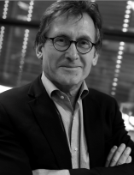
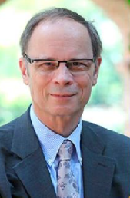
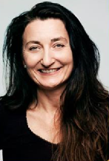
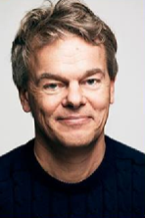
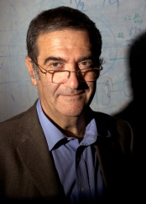
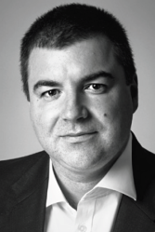
Nobel Prizes to ERC grantees
ERC Grantee
AdG 2008
ERC Grantee
AdG 2009
The Nobel Prize in Chemistry 2016 was awarded jointly to Jean-Pierre SAUVAGE, Sir J. Fraser STODDART and Bernard L. FERINGA "for the design
and synthesis
of molecular machines".
The Nobel Prize in Economic Sciences 2014 was awarded to Jean TIROLE "for his analysis of market power and regulation".
ERC Grantee
AdG 2015
Bernard FERINGA
Nobel 2016
Jean TIROLE
Nobel 2014
ERC Grantee
AdG 2010
ERC Grantee
AdG 2008
ERC Grantee
AdG 2009
ERC Grantee
StG 2007
ERC Grantee
AdG 2013
ERC Grantee
SyG 2012
May-Britt MOSER
Nobel 2014
Edvard
MOSER
Nobel 2014
Serge HAROCHE
Nobel 2012
Konstantin
NOVOSELOV
Nobel 2010
The Nobel Prize in Physiology or Medicine 2014 was awarded to May-Britt MOSER and Edvard MOSER, together with John O'KEEFE, "for their discoveries of cells that constitute a positioning system in the brain".
2 other ERC grantees received the Nobel prize in 2010 and 2012
Other 7 ERC grantees were already Nobel laureates at the moment they received the ERC grant
│ 19

Slide 20
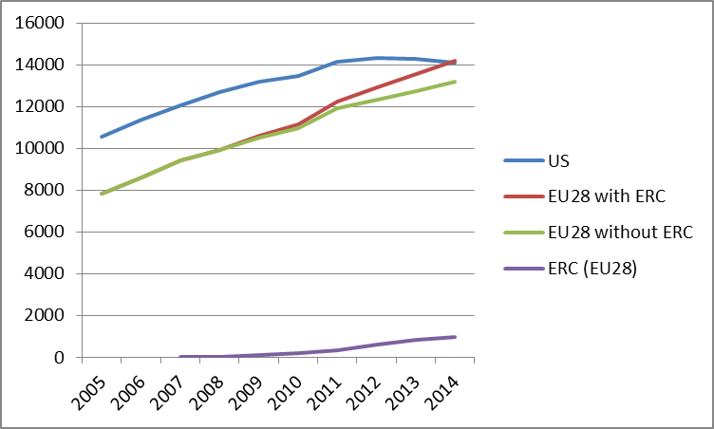
ERC: Putting Europe Back on the Map
The first reported ERC publications began to appear in 2007 and since then publications acknowledging ERC funding have gone from contributing less than 0.1% of EU top 1% publications in 2007 (2) to nearly 7% in 2014 (973).
In 2014, for the first time authors based in the EU appeared on more top 1% cited publications (14,172) than authors based in US (14,093) in absolute numbers.
Diagramme until 2014 (1% most cited Publications)

Slide 21
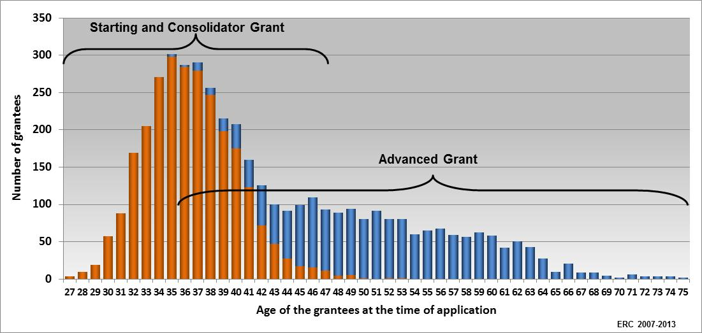
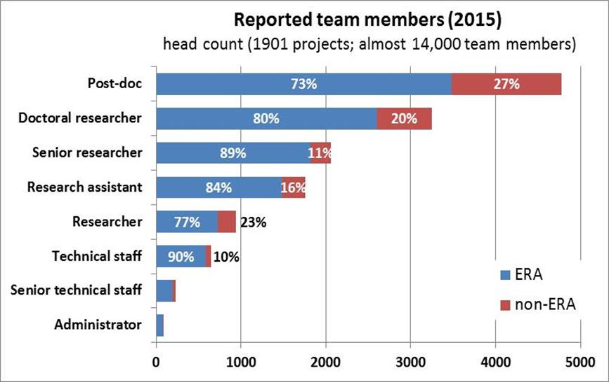
Priority to Young Scientists
+ 30 000 PhD and post-doc researchers working in ERC teams.
Two-thirds of ERC grants to early-stage Principal Investigators.

Slide 22
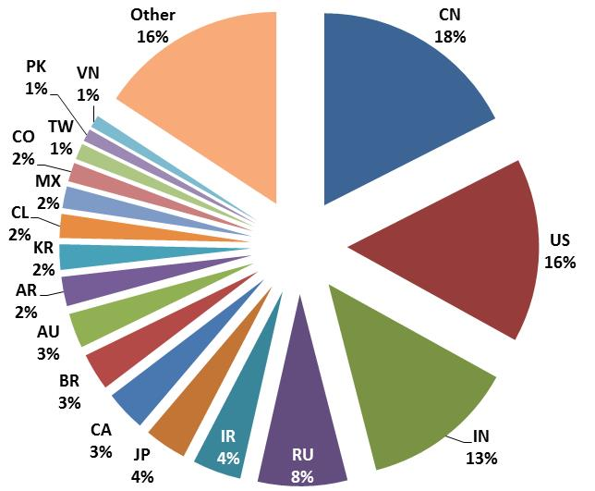
Attracting Researchers to Europe
Nationality of ERC project teams (PIs not included)
Analysis of 1,901 Starting and Advanced Grants
EU: 71%
Assoc. Countries: 10%
non-ERA: 17%
unknown: 2%
In all ERC grants
+ 9,000 non-ERA team members
most from
China, US, India, and Russia

Slide 23
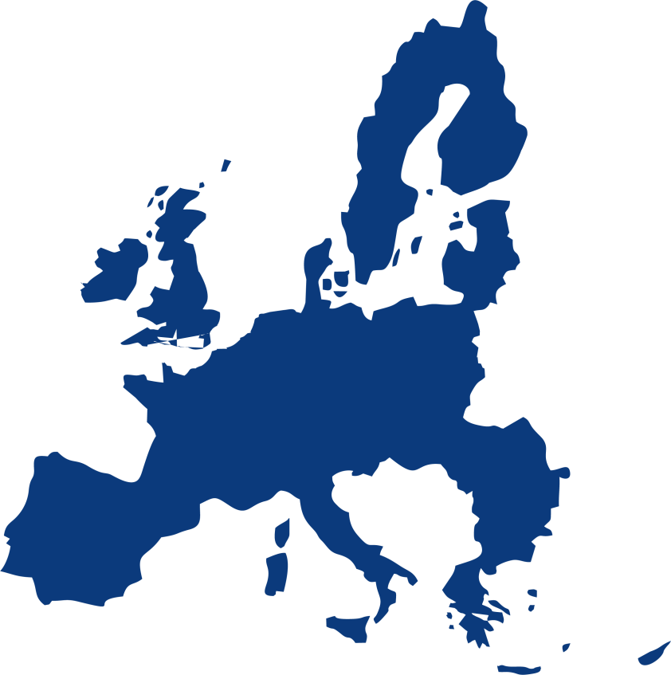

Inspiring Reforms in Europe
The ERC has set the benchmark of competitive funding of basic research
New scientific councils and funding schemes launched in EU Member States
At least 17 countries have introduced initiatives to finance their best unfunded applicants

Slide 24
Two Examples of ERC Structural Effects
Poland: the National Science Centre (NCN) was created in 2010 for the purpose of further decentralisation of the science system financing and transferring to scientific communities the competence of defining the basic-research development directions. The ERC structure was the model for NCN and the ERC funding schemes and procedures an inspiration for their funding instruments.
Greece: the Hellenic Foundation for Research and Innovation (ELIDEK) was established in 2016 following the ERC model.
"Through ELIDEK, the research and academic community is, for the first time, actively involved in shaping the country’s research and innovation policy without thematic or geographical exclusions, but with the sole criterion of scientific quality and excellence." (ELIDEK website)

Slide 25
Frontier Research leads to Innovation
With 17% of the budget of the 7th Framework Programme (FP7),
the ERC accounts for 29% of FP7-funded patent filings (>800)
Thematic
concept map of ERC supported inventions

Slide 26
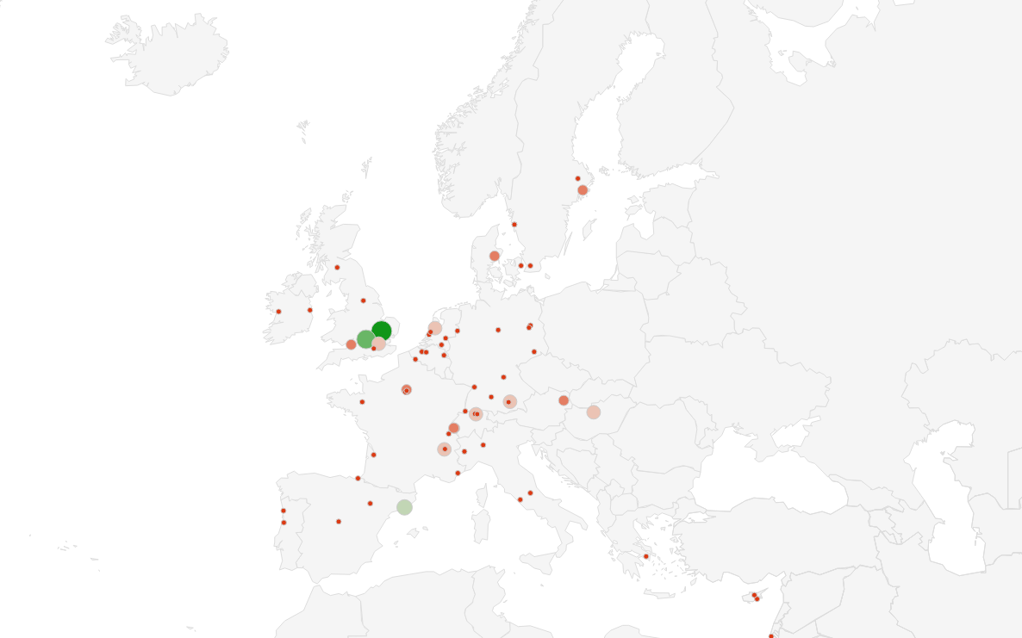
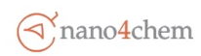
















































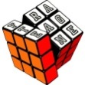










































101 Spin-offs from ERC Projects

Slide 27
Next MFF: a Political Opportunity
ERC Perspectives

Slide 28
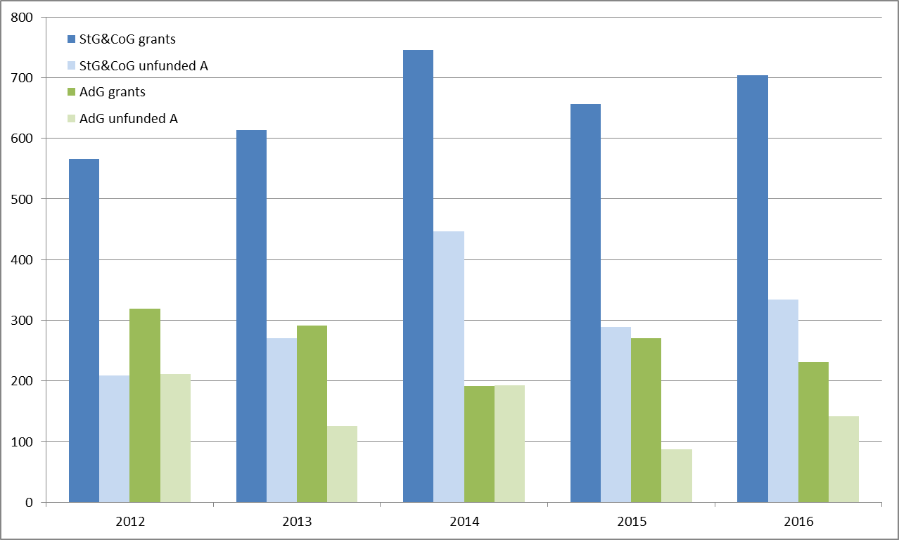
Need for Budget Increase:
More Talent to Fund
With a higher budget, ERC could fund much more excellence across Europe.
There has been an average of >400 unfunded top-quality projects each year in the recent past. Unfunded talents may leave or not return to Europe.

Slide 29
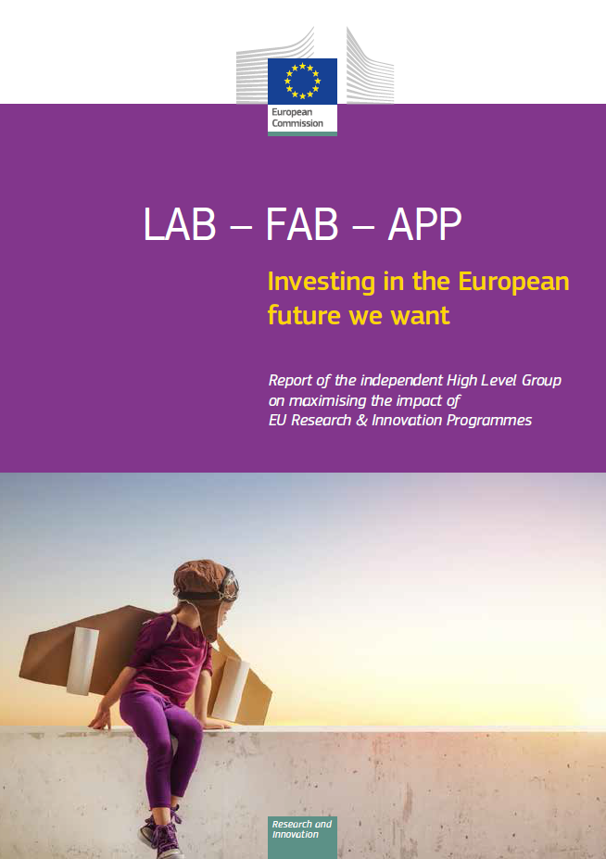
A Lot is Expected of the ERC
"Reducing the overall level of R&I investment would be a mistake a clear reversal of progress. At a minimum, the budget should maintain the average annual growth rate of Horizon 2020, [which…] would lead to a seven-year budget of at least €120 billion at current prices.
"Increasing the budget of the post-2020 EU R&I programme will provide more resources for the European Research Council (ERC), which finances projects defined and driven by researchers on the sole criterion of excellence. As shown by the interim evaluation of Horizon 2020, the ERC has become a global beacon of excellence and provides those that do the science of the future with the skills and competences that Europe needs to stay at the forefront of development"
European Commission "LAB- FAB – APP" Report (2017)

Slide 30
ERC Scientific Council Document on FP9
In the space of 10 years, the European Research Council (ERC) has become a real European success story. Its original set-up and governance adds a new dimension to the European Union (EU) Framework Programmes, and the funding it provides for the best investigator-driven frontier research complements national efforts. The EU should build on this achievement and scale-up the ERC. Beyond 2021, Europe needs to increase its overall investment in research and innovation to speed up its progress towards becoming a dynamic knowledge society empowering researchers to develop their boldest ideas broadly.
https://erc.europa.eu/news/erc-scientific-council-statement-position-erc-next-eu-framework-programme
Continuity
Agility
Scale-up

Slide 31
ERC Scientific Council Document on FP9
Set of key principles proposed by the ERC Scientific Council for the transition into the next Framework Programme: we need your support!
Continuity:
  Of structure from the current legal framework
  Of governance arrangements: independence of Scientific Council and operational autonomy
Agility:
  To innovate and adapt its scientific strategy
  To manage its resources flexibly
  To use tailor made tools and procedures when necessary
Scale-up:
  To turn ERC into one of Europe's main funders
  To ensure appropriate success rates
  To support more Europe's top-performing researchers

Slide 32
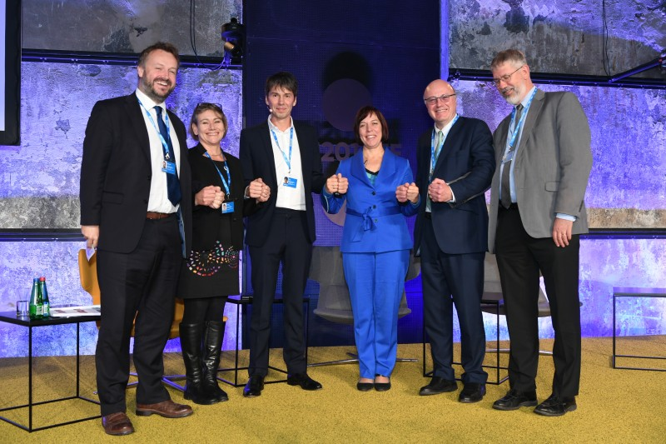
The Tallin Call for Action October 2017
"Investing in research and innovation is a necessity for competitiveness, not a luxury. Intelligence, creativity and the capacity to act are Europe’s main strengths and source of wealth. Europe will not become the forerunner in creating excellent ideas and applying new knowledge if public R&I investments are cut or stagnate."
"Excellent research is the basis for education and future innovation. There is too much pressure for public funding to focus on R&I activities that produce short-term outcomes, neglecting the many contributions of research to society and the economy, including equipping people with the skills they need to thrive in future jobs."

Slide 33



The European Research Council
More information: erc.europa.eu
National Contact Point: erc.europa.eu/national-contact-points
Sign up for news alerts: erc.europa.eu/keep-updated-erc
Follow the ERC on
www.facebook.com/EuropeanResearchCouncil
twitter.com/ERC_Research
www.linkedin.com/company/european-research-council

