Slide 1
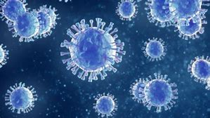
The Bulgarian Academy of Sciences and the COVID-19 pandemic
Prof. D.Sc. Julian Revalski, President

Slide 2
Activities of the Bulgarian Academy of Sciences:
Special section on the BAS website devoted to scientific messages and policies for fighting the coronavirus.
Active media presence of BAS scientists on COVID-19 related topics.
Scientists from the Institute of Molecular Biology are actively participating in the PCR testing at the Pirogov Hospital for active treatment and emergency medicine in Sofia.
Scientists from the Institute of Microbiology are working on a vaccine in cooperation with the Pasteur Institute in France.
Mathematical models in the field of epidemiology for prediction of the dynamics and processes related to the spread of the coronavirus are developed by the Institute of Mathematics and Informatics and the Institute of Mechanics.
Economic measures and models for after the end of the state of emergency are developed by the Economic Research Institute.
Masks with activated carbon filter as adsorbent were developed by the Institute of Organic Chemistry.
Stress under coronavirus infection conditions – how to overcome it - Institute for Population and Human study
A crisis headquarters was formed at the BAS for working measures during the state of emergency.

Slide 3
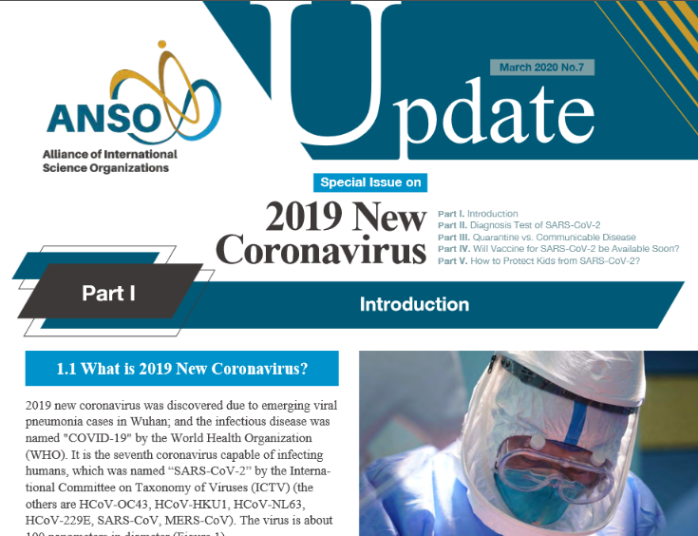
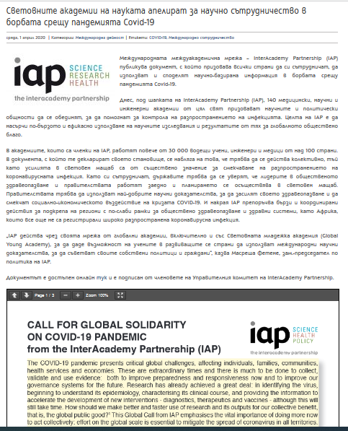
Special section on the BAS website
Among important national news we have published also:
Leopoldina statements;
Coronavirus Pandemic in Germany: Challenges and Options for Intervention;
2nd Ad-hoc Statement: Coronavirus Pandemic – Measures Relevant to Health;
3rd Ad-hoc Statement: Coronavirus Pandemic – Sustainable Ways to Overcome the Crisis
Imperial College London research ‘Estimating the number of infections and the impact of non-pharmaceutical interventions on COVID-19 in 11 European countries’
IAP Call for Global solidarity
ANSO newsletters on coronavirus

Slide 4
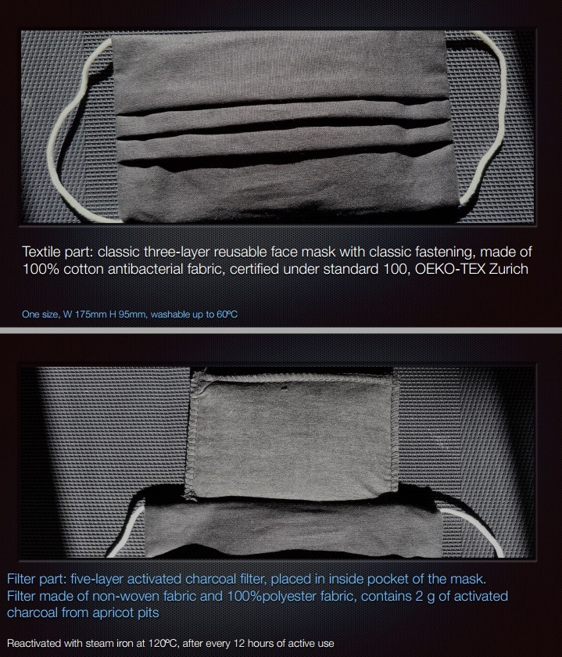
Masks developed by the Institute of Organic Chemistry
The work is focused on prevention: Masks with activated carbon filter as adsorbent have already been developed and tested against viruses with a size similar to the one of coronaviruses. The activated carbon was obtained from apricot kernel (wastes). The masks have already shown that the viruses do not leak and cannot pass through the mask for up to 50 hours. The mask can be reused and steam sterilized.
In addition, different synthetic compounds and natural products (extracts) will be tested in order to find therapeutic or active substance against coronavirus 229E strain.

Slide 5
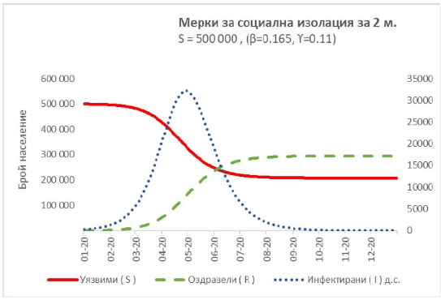
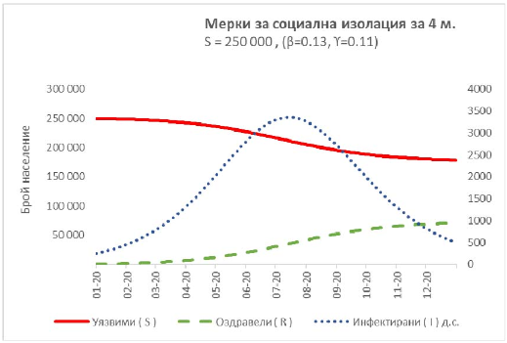
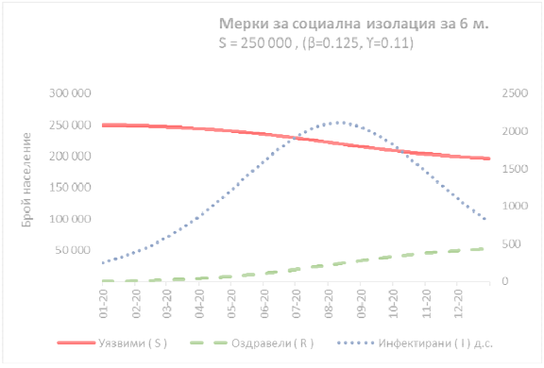
Economic measures and models
The forthcoming recession is based on the vulnerability of the human factor;
The analysis assesses the socio-economic consequences of the fight against COVID-19;
An overview of the monetary and fiscal measures taken in the countries which are the main trade partners of Bulgaria is presented;
Three possible scenarios for the development of the Bulgarian economy by the end of the year are proposed;
The measures taken so far by the government have been assessed and some specific recommendations have been made.

Slide 6
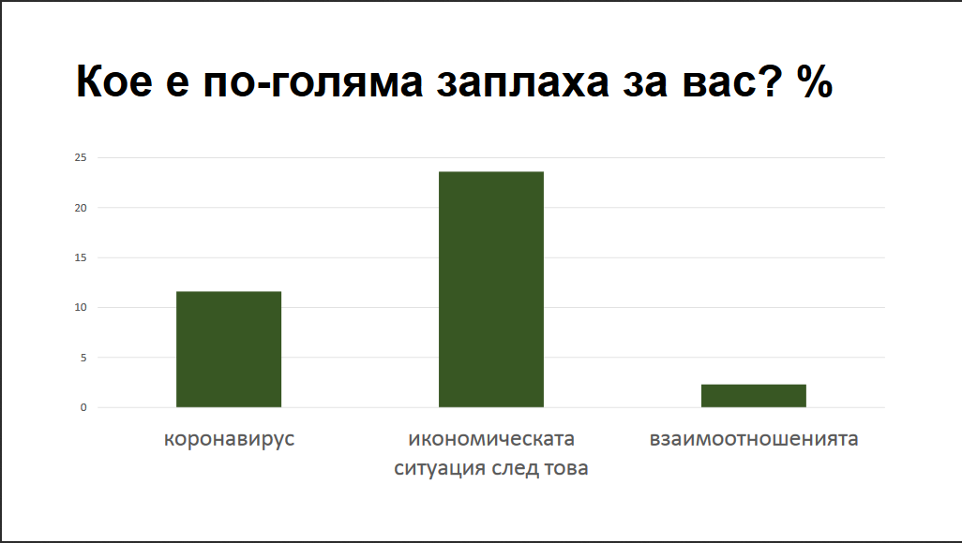
Stress under coronavirus infection conditions – how to overcome it
The Department of Psychology at the Institute for Population and Human Studies – Bulgarian Academy of Sciences (IPHS-BAS) implemented the second wave of research on stress responses and how to deal with it in conditions of spreading coronavirus infection in Bulgaria
The survey was conducted between 25 April and 2 May 2020 among a random sample of 868 persons surveyed.
An additional focus of interest in the second wave is social change and the impact of social exclusion. The study continues also with the support of the International Sociological Association in Sweden, Germany, Portugal, Italy and China.

