Slide 1
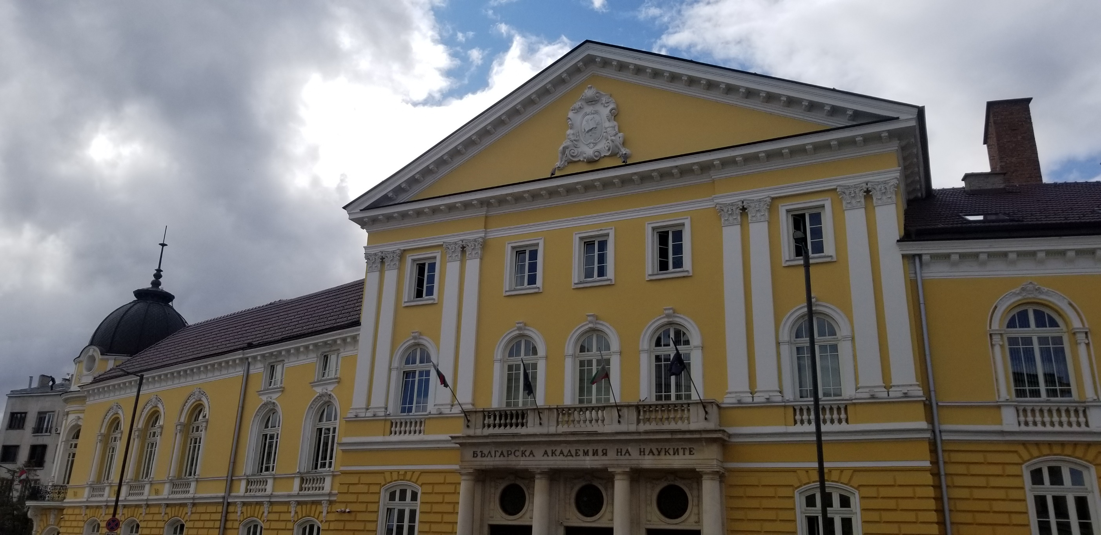
Bulgarian Academy of Sciences: Idea and Realization (1824-1944)
Dimiter Christov,
Institute for Historical Studies – Bulgarian Academy of Sciences
2024

Slide 2
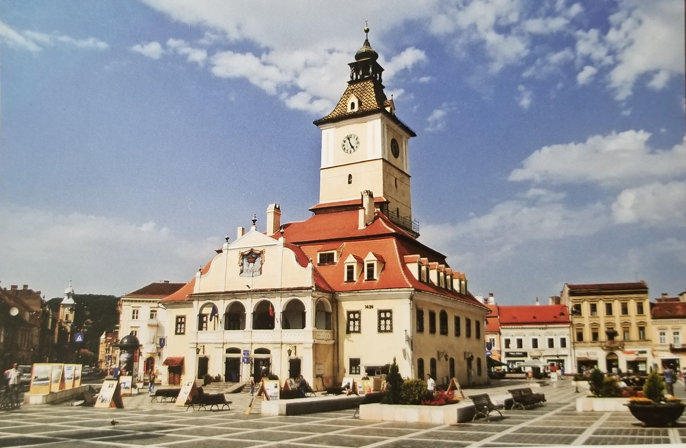
Bulgarian academy as an idea (1824-1869)
Romania – host of the first attempts to organise Bulgarian knowledge.
In the beginning of the 19th century a lot of Bulgarians (incl. artisans and traders) settled in Wallachia and Moldova in search of better economic prospects. The Wallachian Uprising of 1821 forced many of them to find temporarily a refuge in Transylvania.

Slide 3
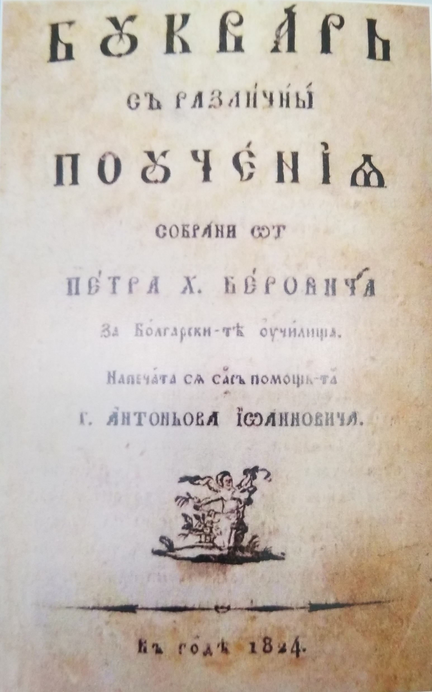
The Bulgarian Intellectual Circle in BRAṢOV (1821-1828)
A group, which gathered in BraṢov, formed a kind of intellectual circle with education awareness. The circle made the first attempt to organize a collective literary activity among the Bulgarians in 1824-1828.
The most significant result from the circle’s work was the ‘Alphabet Textbook with Various Morals’ (1824) by Peter Beron, popular as ‘The Fish Alphabet Textbook’.

Slide 4
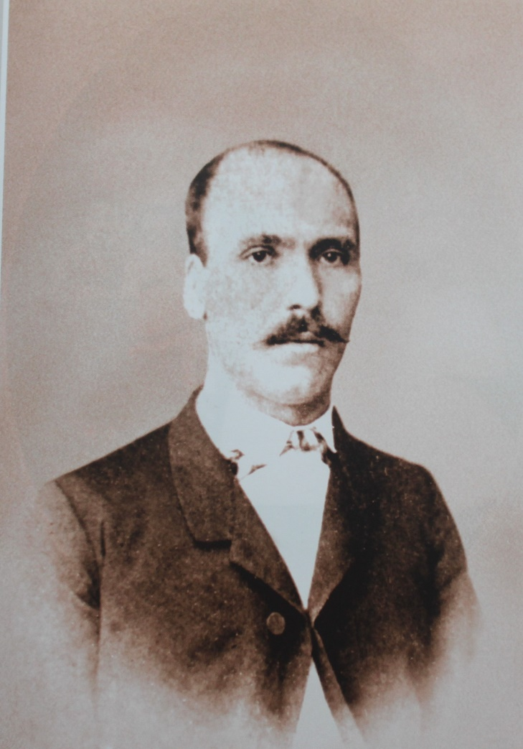
Centers of the Bulgarian Emigration in mid-19th century
Constantinople
Odessa
Bucharest
Galati
Braila
Dobri Voinikov – playwright, ‘father of the Bulgarian comedy’, resident of Braila

Slide 5
The Bulgarian Literary Society in Braila (1869-1878)
"... after many attempts to create a nationwide institution, the sole purpose of which is to spread enlightenment among our people , today there is already such an institution, under the name:
"Bulgarian Literary Society"
Photography: Daniela Vichkova

Slide 6
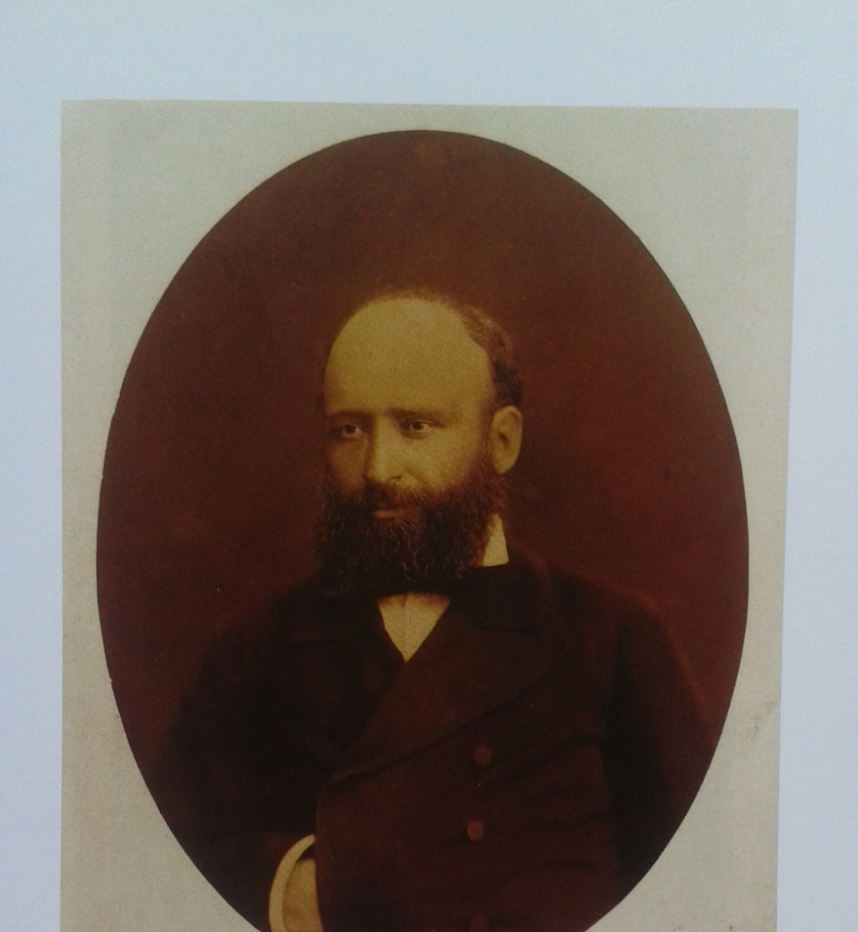
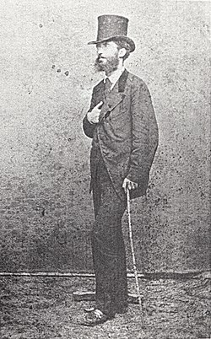
The founding members: Marin Drinov, Vassil D. Stoyanov , Metropolitan Clement of Turnovo (Vassil Drumev) And the Society’s Secretary Todor Peev

Slide 7
The backbone of the Bulgarian Literary Society
Nikola Tsenov from Sliven, poorly educated himself, most zealous supporter of learning and knowledge. He came young in Braila, became a wealthy merchant, benefactor of Bulgarian education and chairman of the Board of Trustees of BLS until 1878.
His Braila home housed the BLS during the entire period from its foundation to the Liberation.

Slide 8
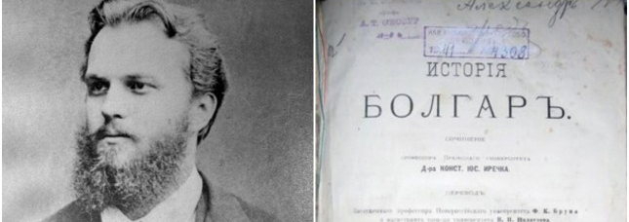
The Bulgarian literary Society moved to Sofia (1878-1881)
Konstantin Irecek – Czech scholar, author of “History of the Bulgarians” (1876), expert in the Ministry of public education in Bulgaria (1879-1884)

Slide 9
"Mind reigns, mind struggles in slavery...": The Periodical magazine of the BLS
The motto is a contraction of a Bulgarian folk saying: “Mind reigns, mind struggles in slavery, mind grazes ducks”

Slide 10
The change of 1898: End of passiveness
Dr. Dimitar Mollov – medical doctor and politician; vice-president of the BLS (1898-1911)
Ivan Ev. Geshov – merchant, economist and politician; Chairman of the BLS (1898-1911) and the BAS (1911-1924)

Slide 11
1911: The Bulgarian Literary society turned into Bulgarian academy of sciences
The Bulgarian Academy of Sciences (BAS) established formally with an Act of the National Assembly (1911)

Slide 12
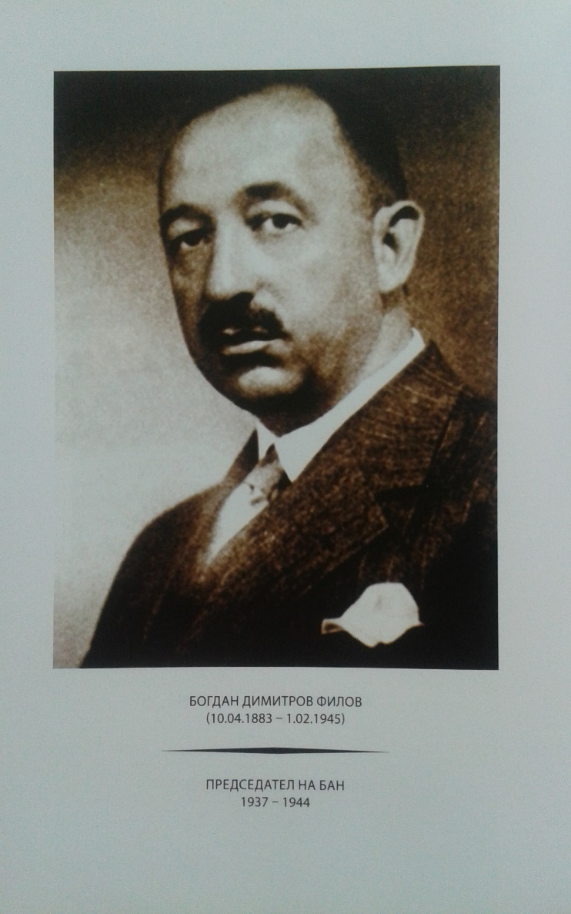
The Bulgarian Academy of Sciences as an elite scholarly club (1911-1945)
Ivan Ev. Gueshov - chairman of BAS (1911-1924)
Bogdan Filov – archaeologist, chairman of BAS (1937-1944), prime minister (1940-1943), regent (1943-1944).
Lubomir Miletich – philologist, chairman of BAS (1924-1937).

Slide 13
The Act of 1940: Bulgarian Academy of sciences and Arts
9th September 1944: Communist-led Revolt in Bulgaria
The Academy under strong political pressure from the Left-wing forces to adopt a Soviet model

